Slide 1
Hardware Components
Presented to Prof. Mike Aleshams
Presented by Manu S. Parbhakar

Slide 2
A Brief Introduction Of The Project: Smart Greenify Device
The device has sensors to detect the water level, humidity, and temperature, and all these parameters can be controlled by the particular plant’s requirement.
Grow lights will be used to give artificial sunlight to the plants. We will have a log of data of the different varieties of plant species and their requirements stored in the memory.
All the data and controls can be accessed on a handheld device wirelessly over Bluetooth. We also will have a camera to monitor the Plant’s health.
Image Processing is embedded in the main system since the camera will pick up any weird spots and color changes on the leaves of the plants, then analyze them with a library then notify the user.
Auto-adjusting temperature: with an optional enclosed space, the temperature in each slot of the device can be adjusted to a suitable level for any particular plant.

Slide 3
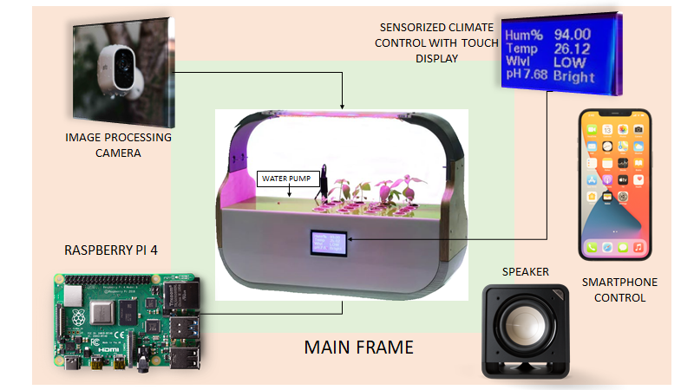

Slide 4
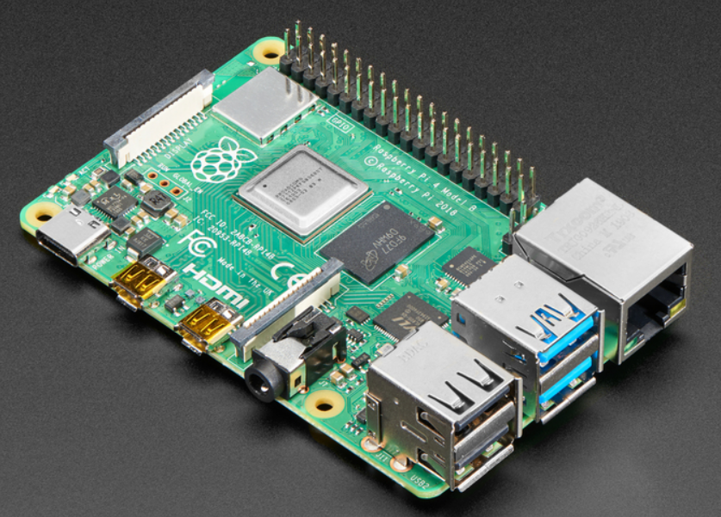
Raspberry Pi 4
SPECIFICATIONS
Broadcom BCM2711, Quad core Cortex-A72 (ARM v8) 64-bit SoC @ 1.5GHz
2GB, 4GB or 8GB LPDDR4-3200 SDRAM (depending on model)
wireless, Bluetooth 5.0, BLE
Gigabit Ethernet
2 USB 3.0 ports; 2 USB 2.0 ports.
Raspberry Pi standard 40 pin GPIO header (fully backward compatible with previous boards)
2 × micro-HDMI ports (up to 4kp60 supported)
2-lane MIPI DSI display port
2-lane MIPI CSI camera port

Slide 5
Raspberry Pi 4
SPECIFICATIONS
4-pole stereo audio and composite video port
H.265 (4kp60 decode), H264 (1080p60 decode, 1080p30 encode)
OpenGL ES 3.0 graphics
Micro-SD card slot for loading operating system and data storage
5V DC via USB-C connector (minimum 3A*)
5V DC via GPIO header (minimum 3A*)
Power over Ethernet (PoE) enabled (requires separate PoE HAT)
Operating temperature: 0 – 50 degrees C ambient
* A good quality 2.5A power supply can be used if downstream USB peripherals consume less than 500mA in total.

Slide 6
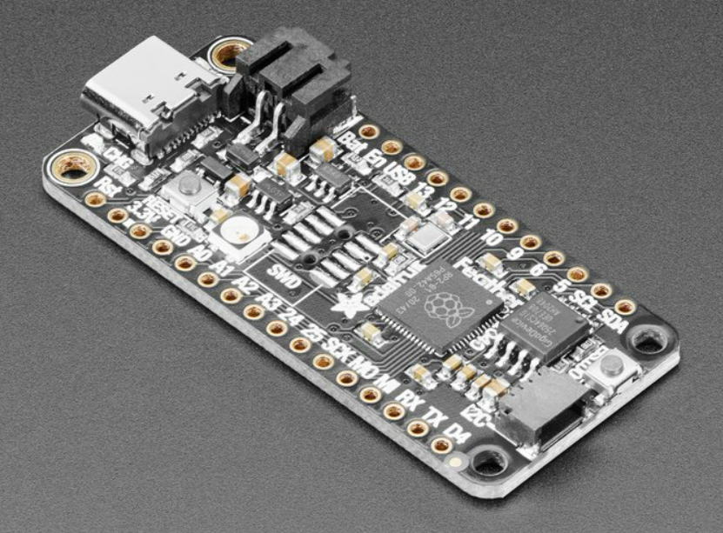
Adafruit Feather RP2040
SPECIFICATIONS
Measures 2.0" x 0.9" x 0.28" (50.8mm x 22.8mm x 7mm) without headers soldered in
Light as a (large?) feather - 5 grams
RP2040 32-bit Cortex M0+ dual core running at ~125 MHz @ 3.3V logic and power
264 KB RAM
8 MB SPI FLASH chip for storing files and CircuitPython/MicroPython code storage. No EEPROM
Built in 200mA+ lipoly charger with charging status indicator LED
Pin #13 red LED for general purpose blinking

Slide 7
Adafruit Feather RP2040
SPECIFICATIONS
RGB NeoPixel for full color indication.
On-board STEMMA QT connector that connects quickly with any Qwiic, STEMMA QT or Grove I2C devices with no soldering.
Both Reset button and Bootloader select button for quick restarts (no unplugging-replugging to relaunch code)
3.3V Power/enable pin
Optional SWD debug port can be soldered in for debug access
4 mounting holes
24 MHz crystal for perfect timing.
3.3V regulator with 500mA peak current output
USB Type C connector can access built-in ROM USB bootloader and serial port debugging

Slide 8
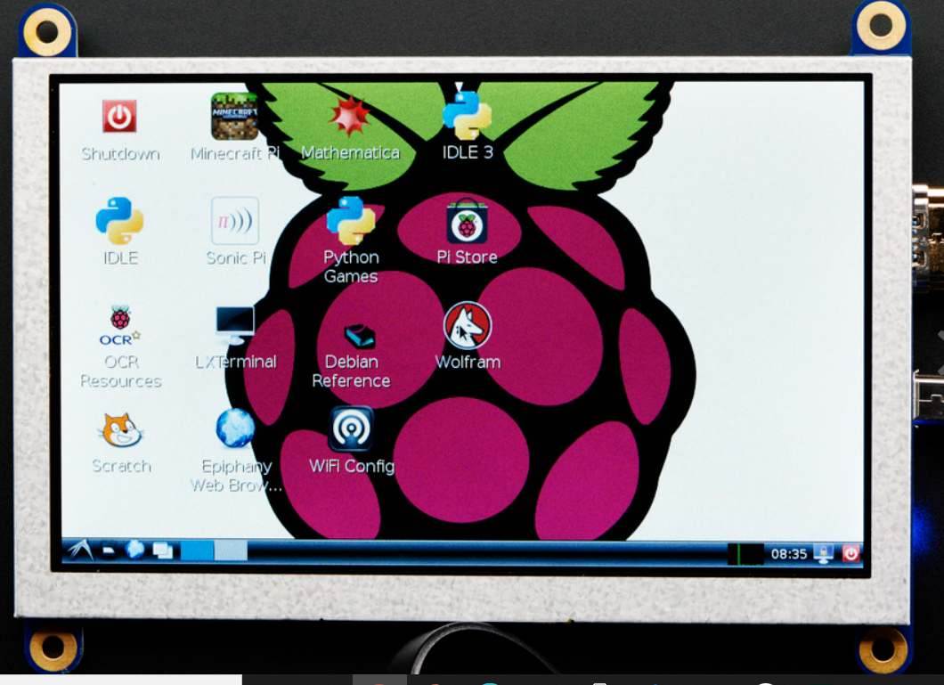
HDMI DISPLAY
A mini panel-mountable HDMI monitor which can easily be connected with any computer that has HDMI output.
It can take unencrypted video and pipe out the raw 24-bit color pixel data.
It can even power the entire display from a USB port.
With the default 5" 800x480 display and 50mA backlight current, the current draw is 500mA total.

Slide 9
HDMI DISPLAY
SPECIFICATIONS
Dimensions: 122mm x 76mm x 7mm / 4.8" x 3.0" x 0.3"
Mounting Hole Distance: 109mm x 81mm / 4.3" x 3.2“a
Mounting Hole Diameter: 2.8mm / 0.11"
Weight: 106g

Slide 10
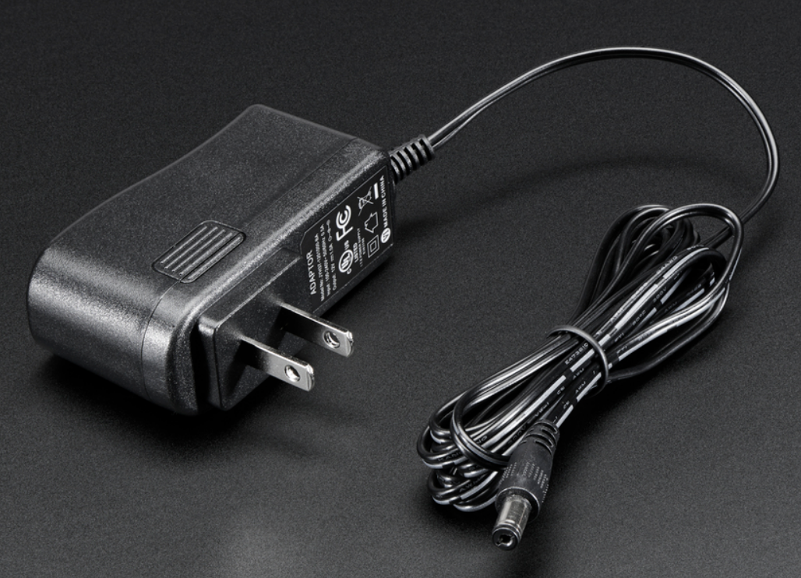
REGULATED SWITCHING POWER ADAPTER
It's a switching DC supply so its small and light and efficient.
The output is regulated by a steady 12V up to 1000mA (1 Amp) of current draw. 5.5mm/2.1mm barrel jack.
SPECIFICATIONS
Wall Wart Dimensions: 71mm x 48mm x 31mm / 2.8" x 1.9" x 1.2"
Cable Length : 178cm / 70"
Cable Diameter : 3.5mm / 0.13"
Weight: 89g

Slide 11
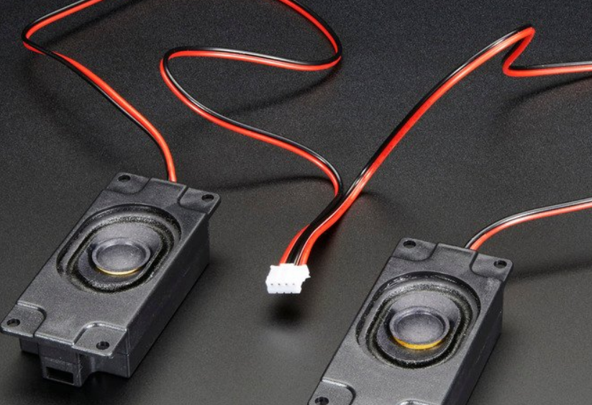
SPEAKER SET
This set of two 2.8" x 1.2" speakers with 4-ohm impedance and 3W or less of power.
The pair have a SPK input cable to add audio to the displays.
The pair works well with 10.1-inch, 7 inch, or 5.6-inch 1280x800 Display w/ Audio driver boards.
Furthermore, they work peachy-keen with any of audio amps as well, such as the MAX98306, TS2012 or TPA2016 stereo class D amplifiers.

Slide 12
SPEAKER SET
Weight: 25g per speaker
Dimensions: 30mm x 70mm x 17mm / 1.2" x 2.8" x .7"
Cable is 30" long total, 15" from each speaker to SPK plug
3.1mm diameter mounting holes
4mm x 64mm mounting rectangle

Slide 13
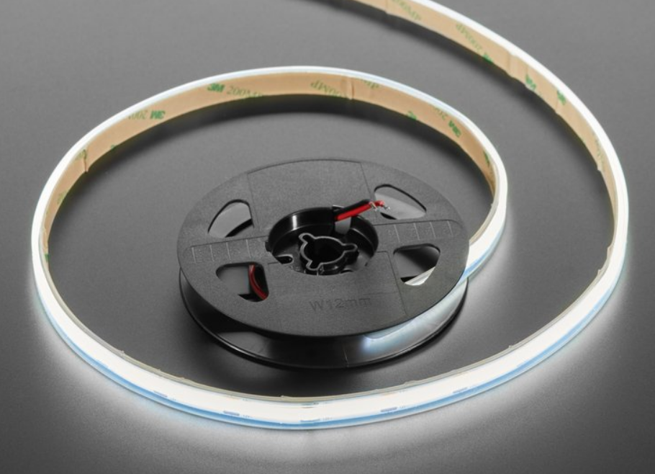
LED STRIP
These 'chip on board' ultra-flexible white LED Strips with 480 SMT LEDs per meter, soldered side-by-side, and diffused with a silicone epoxy.
They look a lot like neon or incandescent tubing or maybe really-nice EL wire, but without the need for expensive transformers, glass tubing, or inert gasses.
These are much thinner and more flexible..

Slide 14
LED STRIP
They are extremely bendy, this strip features a Cool White non-addressable LED strip
They look incredible, and super easy to use, and are a great way to provide the light to the smart greenify device.
The silicone makes for a strong, durable weather-proof casing.
The backing is adhesive and are easy to stick it wherever required.

Slide 15
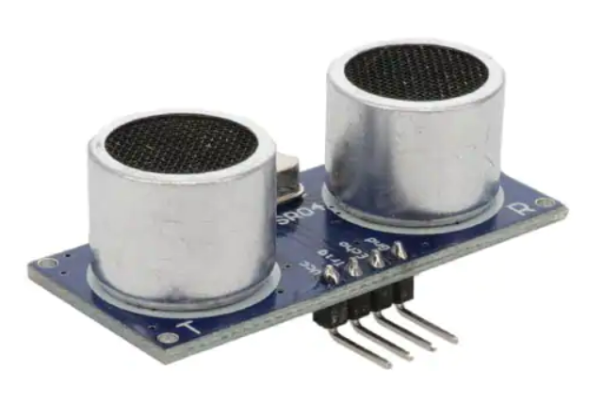
Ultrasonic Sensor
Ultrasonic ranging module HC - SR04 provides 2cm - 400cm non-contact measurement function, the ranging accuracy can reach to 3mm.
Using IO trigger for at least 10us high level signal.
The Module automatically sends eight 40 kHz and detect whether there is a pulse signal back.
IF the signal back, through high level , time of high output IO duration is the time from sending ultrasonic to returning.
Test distance = (high level time×velocity of sound (340M/S) / 2,

Slide 16
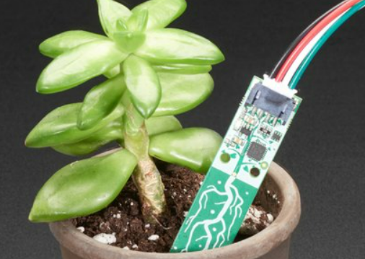
Soil Moisture Sensor
This design is superior with a capacitive measurement. Capacitive measurements use only one probe and is built into the ATSAMD10 chip, which will give a reading ranging from about 200 (very dry) to 2000 (very wet).
As a bonus, it will also give the ambient temperature from the internal temperature sensor on the microcontroller which is good to + or - 2 degrees Celsius.

Slide 17
Soil Moisture Sensor
It can be used any microcontroller with an I2C interface.
Connect a 4-pin JST-PH cable to your microcontroller or single board computer to 3-5V power, Ground, I2C SDA and I2C SCL.
Product Dimensions: 76.2mm x 14.0mm x 7.0mm / 3.0" x 0.6" x 0.3"
Product Weight: 4.0g / 0.1oz

Slide 18
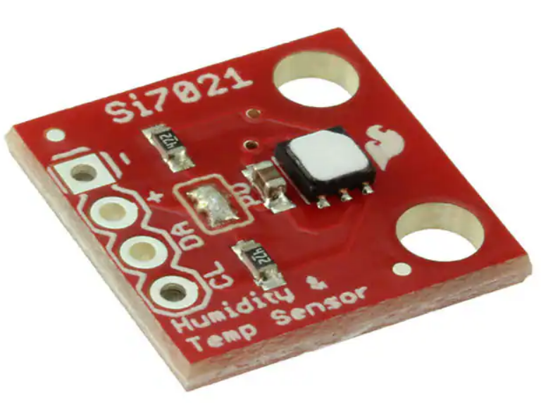
Humidity Sensor
The Si7021 I2C Humidity and Temperature Sensor is a monolithic CMOS IC integrating humidity and temperature sensor elements, an analog-to-digital converter, signal processing, calibration data, and an I2C Interface
The Si7021 offers an accurate, low-power, factory-calibrated digital solution ideal for measuring humidity, dew-point, and temperature, in applications ranging from HVAC/R and asset tracking to industrial and consumer platforms.

Slide 19
Humidity Sensor
Precision Relative Humidity Sensor   ± 3% RH (max), 0–80% RH
High Accuracy Temperature Sensor ±0.4 °C (max), –10 to 85 °C
0 to 100% RH operating range
Up to –40 to +125 °C operating range
Wide operating voltage (1.9 to 3.6 V)
Low Power Consumption 150 µA active current 60 nA standby current
Factory-calibrated
3x3 mm DFN Package
Excellent long term stability
Protection during reflow

Slide 20
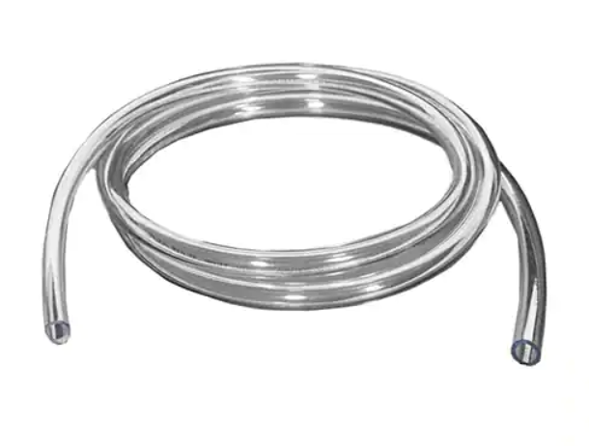
TUBING FOR PUMP
This tubing is designed to go with our simple submersible pumps.. This tubing is made of PVC and is best in use with plant-watering or fountain projects.
It's super easy to cut and is of full meter
Tube length: 1 meter
Tube diameter: 8mm (internal diameter) / 11.5mm (external diameter

Slide 21
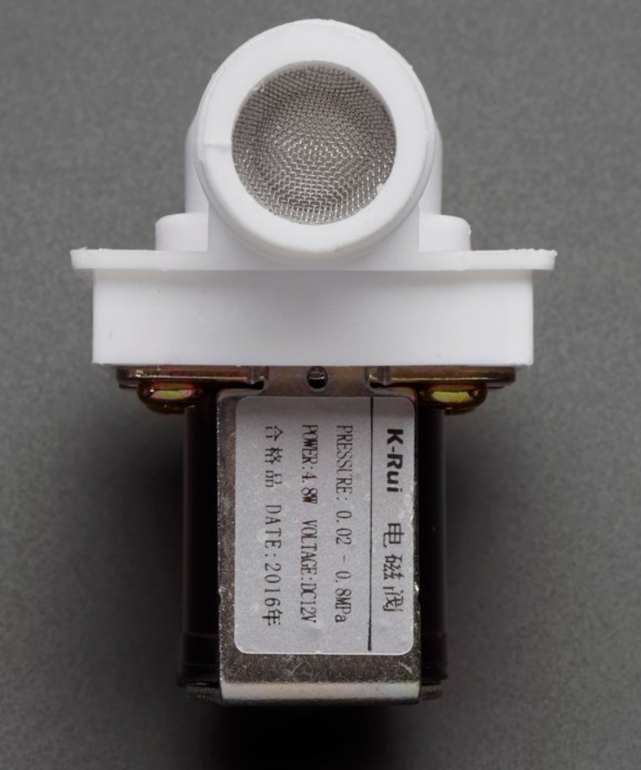
Valve
There are two 1/2" (Nominal non-taped National Pipe) outlet.
When 12VDC is applied to the two terminals, the valve opens and water can push through.
The valve has a gasket arrangement inside, so there is a minimum pressure requirement of 0.02 Mpa (3 PSI).
The solenoid at various DC voltages but however it could be actuated down at 6VDC.

Slide 22
Valve
1/2" Nominal NPS
Working Pressure: 0.02 Mpa - 0.8 Mpa
Working Temperature: 1 ℃ - 75 ℃
Response time (open): ≤ 0.15 sec
Response time (close): ≤ 0.3 sec
Actuating voltage: 12VDC (but we found it would work down to 6V)
Actuating life: ≥ 50 million cycles
Weight: 4.3 oz
Dimensions: 3.3" x 1.69" x 2.24"

Slide 23
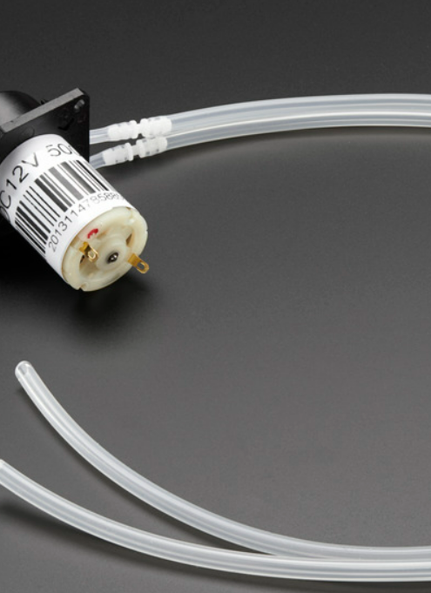
Pump
This is peristaltic type - the pump squishes the silicone tubing that contains the liquid instead of impelling it directly.
The pump is basically a geared down DC motor and has a lot of torque. Inside the pump is a 'clover' pattern of rollers. As the motor turns, the clover presses on the tube to press the fluid though. .
The pump comes with a bit of silicone tubing already installed and two 1/2 meter pieces attached on with barbed connectors.

Slide 24
Pump
Uses approx. 4mm outer diameter, 2mm inner silicone tubing
Working Temperature: 0℃ - 40 ℃
Motor voltage: 12VDC
Motor current: 200-300mA
Flow rate: up to 100 mL/min
Weight: 200 grams
Dimensions: 27mm diameter motor, 72mm total length
Mounting holes: 2.7mm diameter, 50mm center-to-center distance

Slide 25
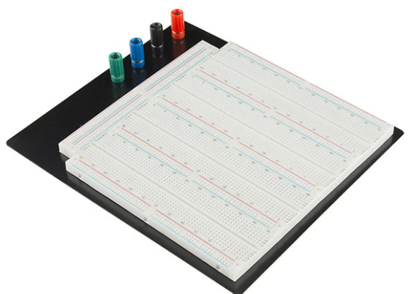
BreadBoard
Description: This is one giant solderless breadboard! It has 7 power buses, 40 columns, and 63 rows - with a total of 3220 tie in points. All pins are spaced by a standard 0.1". The two sets of five columns are separated by about 0.3", perfect for straddling a DIP package over. The board accepts wire sizes in the range of 20-29AWG.

Slide 26
BreadBoard
This board also has 4 binding posts, a black aluminum plate backing, and 4 rubber standoffs to keep your breadboard suspended safely on the workstation.
Dimensions: 9.25 x 8.0 x 1.25" (234.95 x 203.2 x 31.75mm)

Slide 27
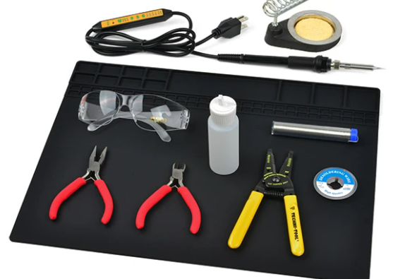
Electronics Toolkit
This is low-cost and easy to transport tools, and created a kit
These tools are enough for simple, surface-mount type assembly, and are perfect for through-hole soldering.
In this version of the kit, there is a silicone soldering mat, a 2oz liquid bottle, and some upgraded wire strippers.

Slide 28
Electronics Toolkit
Insulated Silicone Soldering Mat
Soldering Iron - 60W (Adjustable Temperature)
Solder Lead Free - 15-gram Tube
Soldering Iron Stand
Solder Wick #2 5ft. - Generic
Wire Strippers - 22-30AWG
Diagonal Cutters
Needle Nose Pliers
SparkFun Safety Glasses
Water Bottle - 2oz

Slide 29
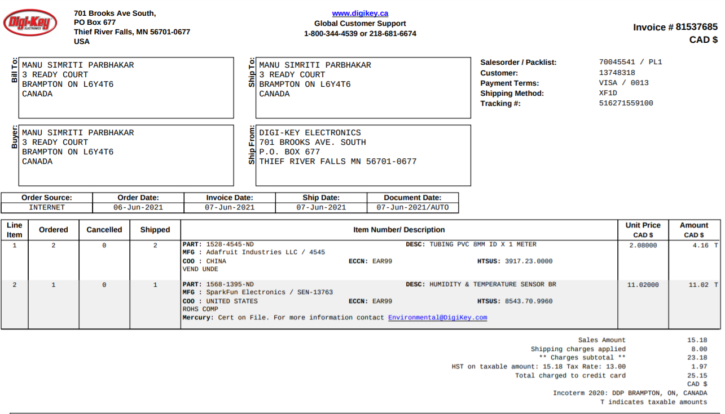

Slide 30
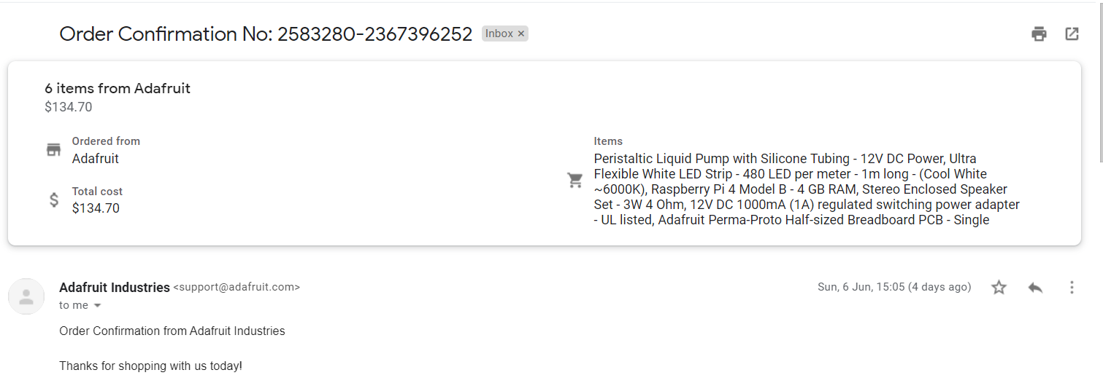

Slide 31
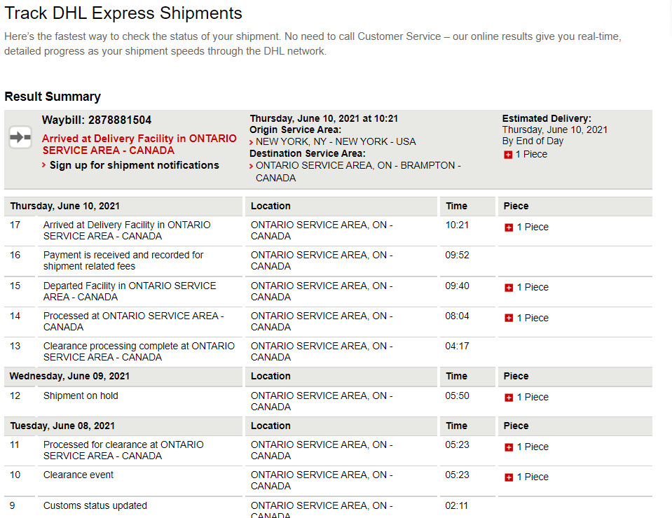

Slide 32
REFERENCES
1. Raspberry Pi 4 Model B specifications – Raspberry Pi. (2019). Raspberrypi.org. https://www.raspberrypi.org/products/raspberry-pi-4-model-b/specifications/
2. AG, I. T. (n.d.). LED Lighting Tech for Urban Farming - Infineon Technologies. Www.infineon.com. https://www.infineon.com/cms/en/discoveries/LEDs-in-Urban-Farming/
3. Plants and Soil Moisture Information | Greener on the Inside. (n.d.). Retrieved June 2, 2021, from https://www.ambius.com/blog/plants-and-soil-moisture/
4. How HDMI Works. (2007, October 8). HowStuffWorks. https://electronics.howstuffworks.com/hdmi
5. How USB Ports Work. (2000, April 1). HowStuffWorks. https://computer.howstuffworks.com/usb.htm#pt3
6. Digi-Key Electronics. (n.d.). DigiKey Electronics Home. Retrieved June 10, 2021, from https://www.digikey.ca/
7. Adafruit Industries, Unique & fun DIY electronics and kits. (n.d.). Adafruit Industries. Retrieved June 10, 2021, from https://www.adafruit.com/

